Slide 1
20XD24 - OBJECT ORIENTED PROGRAMMING
Chapter – VII
Templates

Slide 2
Outline
Introduction to Templates
Generic Functions
Generic Classes

Slide 3
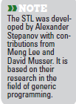
Introduction
C++’s more powerful software reuse features – templates
In general, a template is a pattern or model
Templates are powerful features of C++ which allows us to write generic programs
We can define template functions and classes in C++ using generic types
Templates functions and classes enable programs to work on many different data types without being rewritten for each one
For example
We may define one function for finding the maximum number between two numbers of a generic type. If you invoke this function with two int arguments, the generic type is replaced by the int type
If you invoke this function with two double arguments the generic type is replaced by the double type

Slide 4
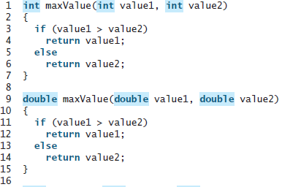
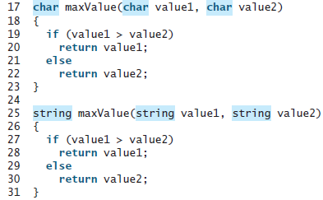
Templates Basics
Templates provide the capability to parameterize types in functions and classes
We can define functions or classes with generic types that can be substituted for concrete types by the compiler
Suppose we want to find the maximum of two integers, two doubles, two characters, and two strings. We might write four overloaded functions as follows:

Slide 5
Templates Basics
Overloaded functions normally perform similar or identical operations on different types of data
If the operations are identical for each type, they can be expressed more compactly and conveniently using function templates
It would save typing, save space, and make the program easy to maintain if you could simply define one function with a generic type
Initially, we write a single function-template definition. Based on the argument types provided explicitly or inferred from calls to this function, the compiler generates separate source-code functions (i.e., function-template specializations) to handle each function call appropriately
In the C programming language, this task can be performed using macros created with the preprocessor directive #define

Slide 6

Function Templates
All function-template definitions begin with keyword template followed by a list of template parameters to the function template enclosed in angle brackets (< and >)
Each template parameter that represents a type must be preceded by either of the interchangeable keywords class or typename
template< typename T > (or)
template< class ElementType > (or)
template< typename BorderType, typename FillType >
The type template parameters of a function-template definition are used to specify the types of the function’s parameters, to specify the return type of the function and to declare variables within the function

Slide 7
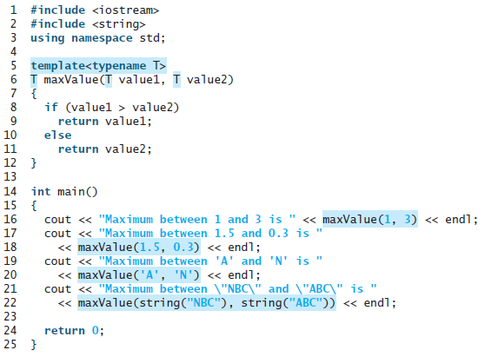

Function Templates
Keywords typename and class used to specify function-template parameters actually mean “any fundamental type or user-defined type”
A template function for finding a maximum value between two values of a generic type

Slide 8
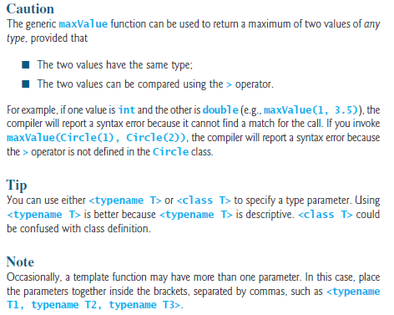
Function Templates

Slide 9
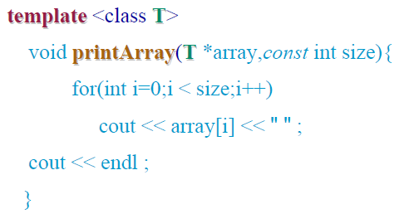
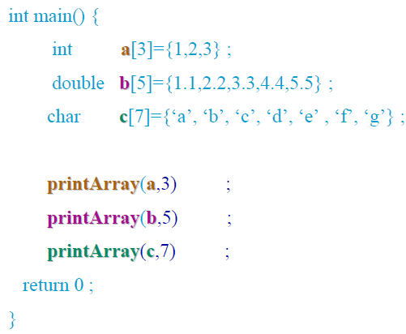
Function Templates – Example 2

Slide 10
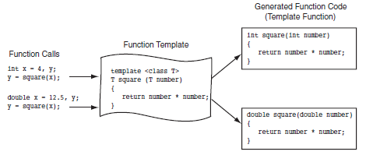

Function Templates

Slide 11
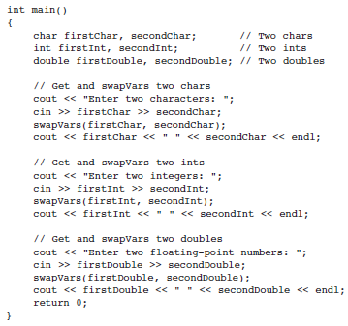
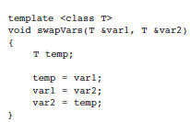

Function Templates – Example 3

Slide 12
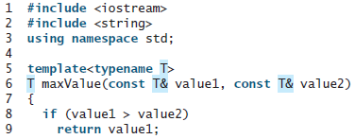

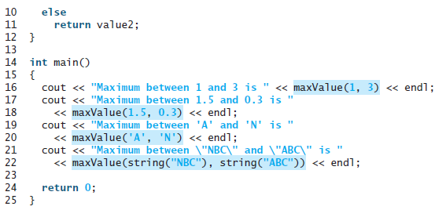
Function Templates
The parameters in the generic function can be modified using pass-by-reference

Slide 13
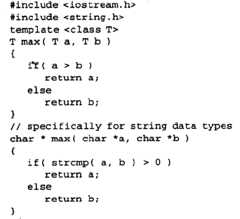
Function and Function Template
Sometimes, it is necessary to override function templates by using normal functions for specific types

Slide 14
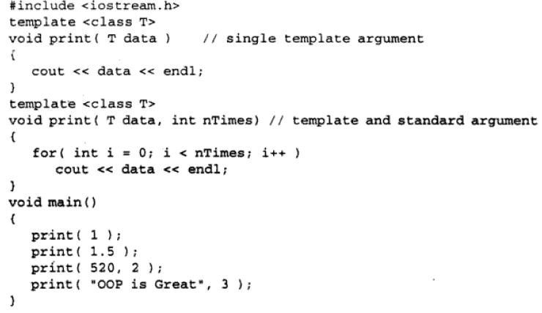
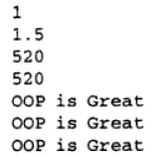
Overloaded Function Templates
The function templates can also be overloaded similar to function overloading

Slide 15
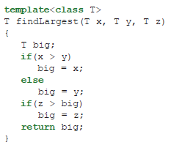
Using Multiple Parameters in Function Templates
Function templates can support multiple parameters
For example : write a function that compares three parameters and returns the largest of the three
This function tempalte will not compile findLargest(int, double, double) or findLargest(double, int, int),
or any other combination in which the parameter types are not the same

Slide 16
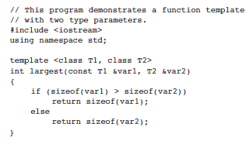
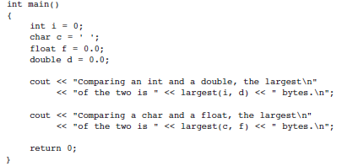

Function Templates with Multiple Types

Slide 17
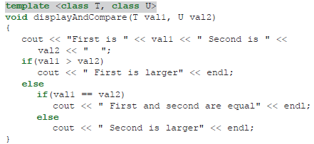
Using more than one Parameterized type in a Function Template
To create a function template that employs multiple generic types, you simply use a unique type identifier for each type
For example
displayAndCompare() function works when any two parameters are passed, whether or not the two parameters are of the same type, as long as > and == are defined correctly for the parameters

Slide 18
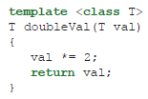

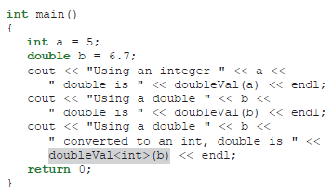
Explicitly Specifying the Type in a Function Template

Slide 19
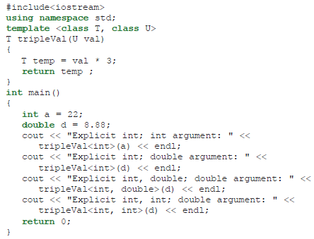

Using multiple explicit types in a Function Template

Slide 20
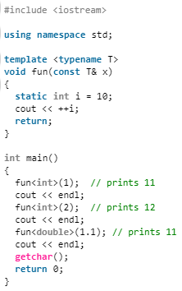
Templates and static Variables
Each instantiation of function template has its own copy of local static variables
For example
Output
11
12
11

Slide 21
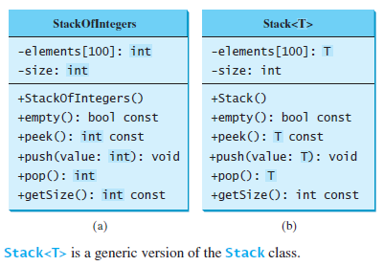
Class Templates
Templates may also be used to create generic classes and abstract data types
Class templates allow you to create one general version of a class without having to duplicate code to handle multiple data types

Slide 22
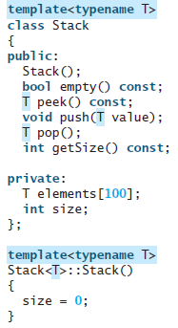
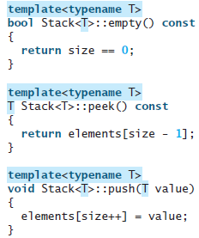
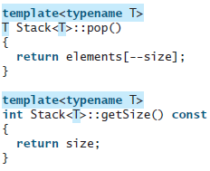
Generic Stack Class – Stack.h

Slide 23
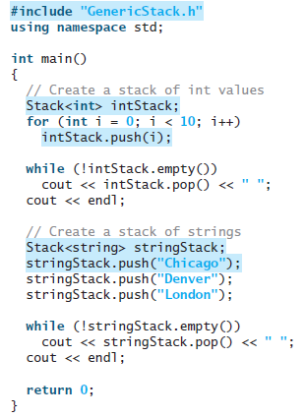

Stack.cpp

Slide 24
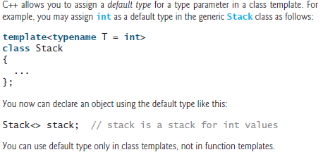
Note
To declare an object from a template class, we have to specify a concrete type for the type parameter T
For example : Stack<int> intStack;
Note :

Slide 25
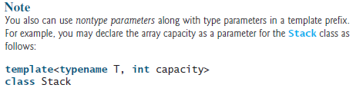
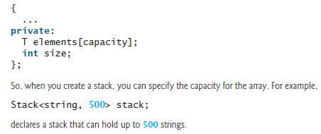

Note

Slide 26
Class Templates and Static Variables
Each instantiation of class template has its own copy of member static variables
For example
int main()
{
Test<int> a; // value of count for Test<int> is 1 now
Test<int> b; // value of count for Test<int> is 2 now
Test<double> c; // value of count for Test<double>
is 1 now
cout << Test<int>::count << endl; // prints 2
cout << Test<double>::count << endl; //prints 1
return 0;
}
#include <iostream>
using namespace std;
template <class T>
class Test
{ private: T val;
public: static int count;
Test()
{ count++; }
// some other stuff in class
};
template<class T>
int Test<T>::count = 0;
Output
2
1

Slide 27
C++ Standard Template Library (STL)
C++ also has a library of data structures, based on templates, but calls them containers
Container is a holder object that stores a collection of other objects (its elements). They are implemented as class templates, which allows a great flexibility in the types supported as elements
Standard Containers - http://www.cplusplus.com/reference/stl/
The C++ Standard Template Library (STL) - https://www.geeksforgeeks.org/the-c-standard-template-library-stl/
  Algorithms
  Containers
  Functions
  Iterators

Slide 28
The C++ vector Class
C++ contains a generic vector class for storing a list of objects
C++ provides the vector class, which is more flexible than arrays. We can use a vector object just like an array, but a vector’s size can grow automatically if needed
To create a vector, use the syntax:
vector<elementType> vectorName;
For example
vector<int> intVector; // creates a vector to store int values
vector<string> stringVector; // creates a vector to store string objects

Slide 29
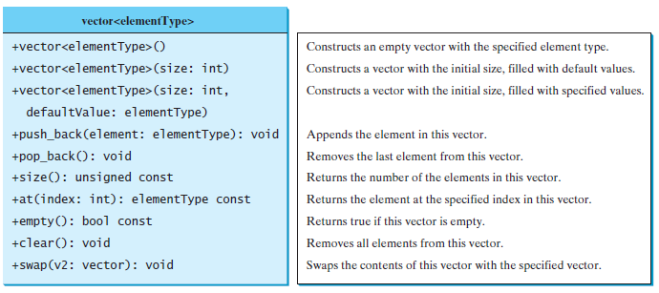
Frequently used functions in the vector class

Slide 30
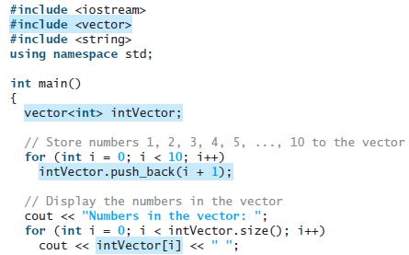
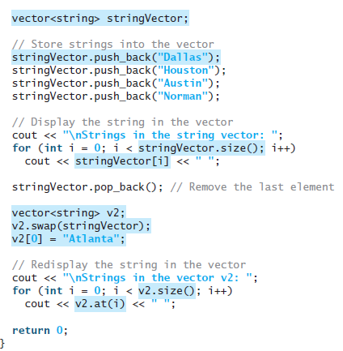

Test_vector.cpp

